Slide 1
Web Mining
CME 4416 – Introduction to Data Mining

Slide 2

Outline
What is Web Mining?
Web Mining
  Web Usage Mining
  Web Content Mining
  Web Structure Mining
Web Mining Applications

Slide 3

What is Web Mining?
Web Mining : Discovering useful information from the World-Wide Web and its usage patterns
Web Mining : The use of data mining techniques to automatically discover and extract information from Web documents / services
Web Mining deals with mining of patterns from web and e-commerce data.
The Web

Slide 4
Web Data
Web Pages
  Billions of Web documents, images, video, etc.
Web Structures
  Link structure of the hypertext from millions of Web sites
Web Logs
  Server/proxy logs, network traffic, and user registrations
E-commerce Sites
  Customer transactions
E-mails, News, Messages
Web-based Telephone Calls
Online Databases and Digital Libraries
…

Slide 5
Web Mining Research
Integration of several research communities such as:
  Database (DB)
  Information Retrieval (IR)
  Machine Learning (ML)
  Natural Language Processing (NLP)
  Electronic Commerce (e-commerce)
  ...

Slide 6
Categories of Web Mining
Web Mining
Web Content
Mining
Web Structure
Mining
Web Usage
Mining
    Clustering Web documents / images
    Classification of Web Pages
    Web Page Summarization
  Purpose
  To mine web data on the web
  Mining the Web’s Link Structures
  Discovery of relations, communities...
  Link based search algorithms
  Purpose
  To provide better structure and grouping of resources,
  To evaluate web sites
  To improve the hypertext struc.
  Discovery of users’ patterns
  E-commerce data analysis
  Web log mining
  Web-Customer Profiling
  Purpose
To understand general access patterns and trends.

Slide 7
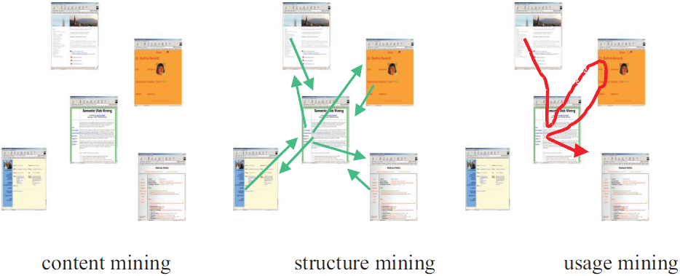
Categories of Web Mining

Slide 8
Categories of Web Mining
Web Mining
Web Content
Mining
Web Structure
Mining
Web Usage
Mining

Slide 9
Web Structure Mining
Mining the Web's Link Structures:
  The Web consists not only of pages, but also of hyperlinks pointing from one page to another
  These hyperlinks contain an enormous amount of latent human annotation
Goals:
  to improve site design and site structure
  to give weight to pages
Problems:
  Not every hyperlink represents an endorsement
  Authoritative pages are seldom particularly descriptive

Slide 10
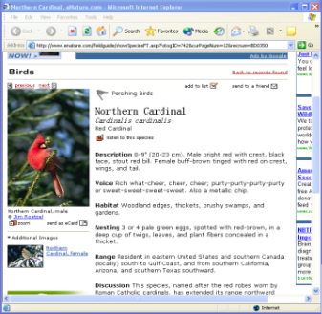
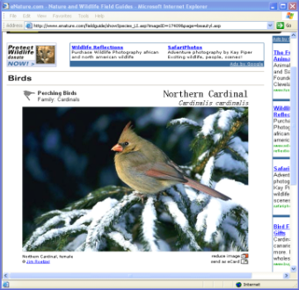
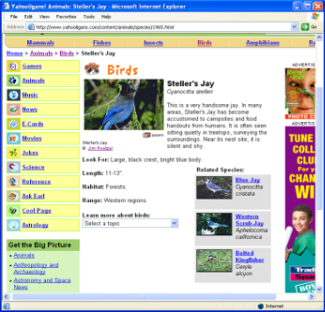
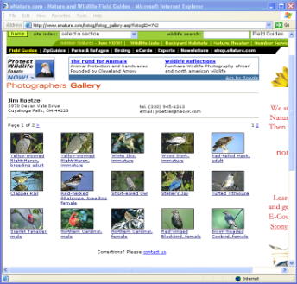
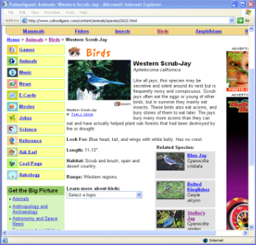
Web Structure Mining Examples
1- Mining Web Images Using Link Structure 2- Block-level Link Analysis

Slide 11
Categories of Web Mining
Web Mining
Web Content
Mining
Web Structure
Mining
Web Usage
Mining

Slide 12
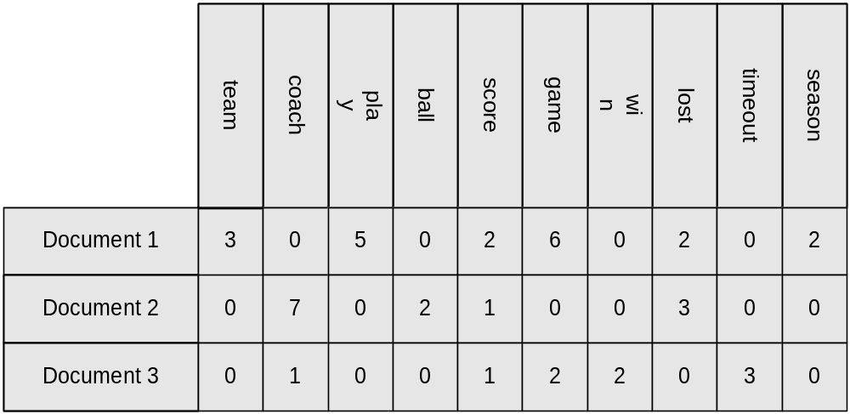
Web Content Mining
Clustering of Web Documents
  Discover groups in the set of documents
    Documents within a group are more similar than documents across groups.
  Subjective disagreements due to
    Different similarity measures
    Large feature sets

Slide 13
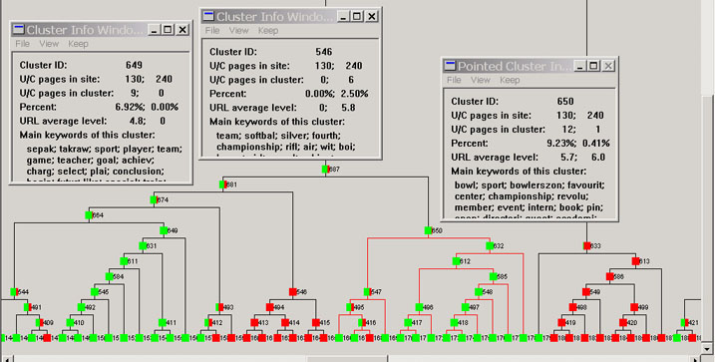
Web Content Mining

Slide 14
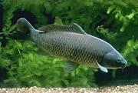
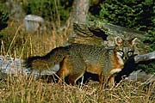
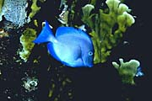
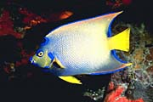
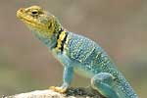
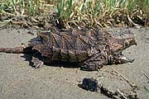
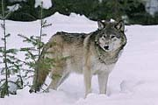
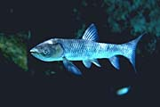

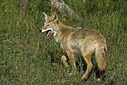
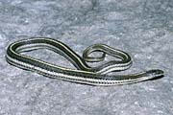
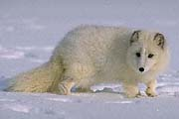
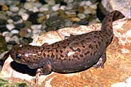
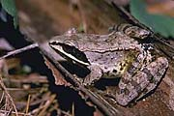

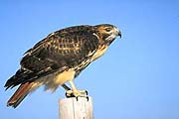
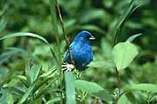
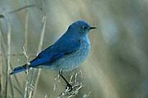
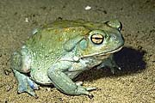
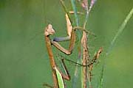
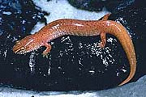
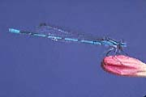

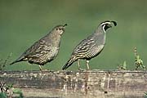
Web Content Mining
Example on Web Image Classification
1710 JPG images in 1287 pages are crawled within the website
http://www.yahooligans.com/content/animals/
Six Categories
Fish
Reptile
Mammal
Bird
Amphibian
Insect

Slide 15
Categories of Web Mining
Web Mining
Web Content
Mining
Web Structure
Mining
Web Usage
Mining

Slide 16







Web Usage Mining
Web User
Application/Web Server
Internet
Web usage data
Web Usage Mining
Knowledge

Slide 17
Web Usage Mining
Mining Web log records to discover user access patterns of Web pages
Mining user’s behaviour
  Click the link
  Browsing time
  Transaction
Goals:
  Improve effectiveness of e-commerce
    Find target potential customers for e-commerce
    To understand general product trends for e-commerce
    Web-Customer Profiling
  Improve Web server system performance
  Identify potential prime advertisements and their locations
  Improve design of individual pages

Slide 18
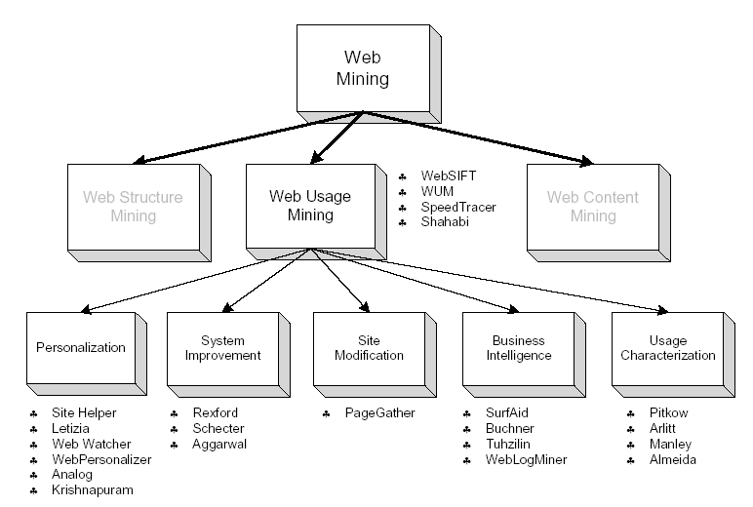
Web Usage Mining

Slide 19
Data Gathering
Who (were the visitors)
  IP, hosts, domains, regions
  User agents, Browser, OS, resolution
When (did they visit)
  By month, week, weekday, hour
What (did they they visit)
  Top pages, entry / exit, …

Slide 20
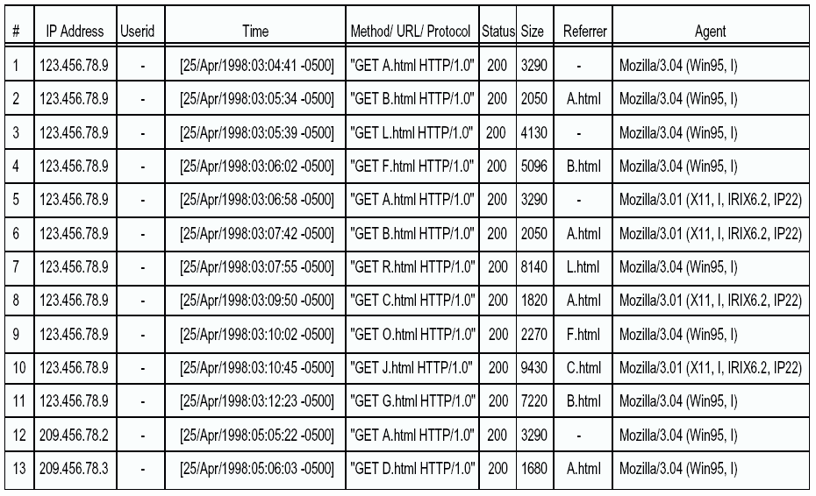
Example Web Logs
SessionID (#) is necessary. In the following example, 4 sessions are determined

Slide 21
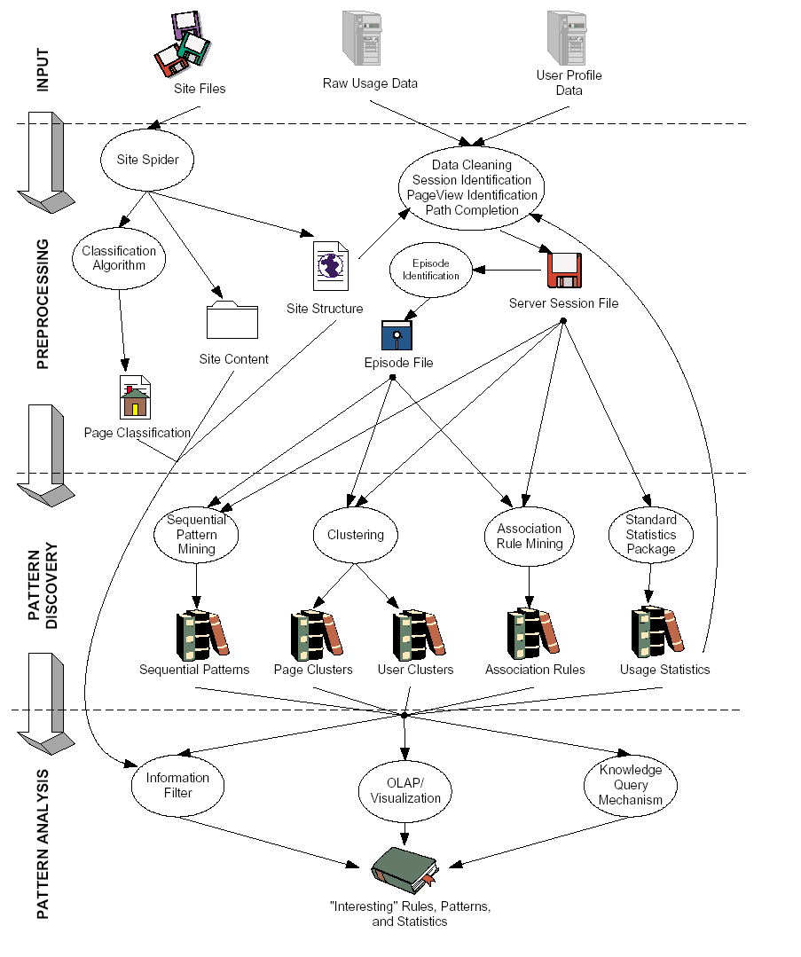
Web Mining

Slide 22




Web Mining Techniques
Web Mining Techniques
  Association Rules
  Sequential Patterns
  Clustering
  Classification
Knowledge
Web log
Database
1
Data Cleaning
2
Data Mining

Slide 23
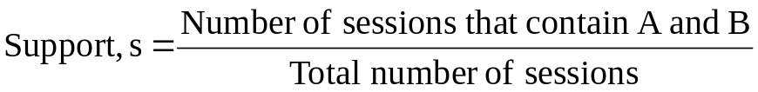
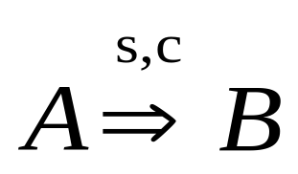
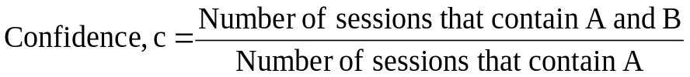
Web Mining Techniques
1- Association Rules
Find pages or products that are most often referenced or purchased or accessed together on the web
  What are the set of pages frequently accessed together by Web users?
Web association patterns are useful:
  To improve Web site design
  To develop prefetching and Web caching policies.
  To recommend related pages
  To collect business intelligence about behavior of Web users

Slide 24
Web Mining Techniques
1- Association Rules
Examples:
40% of users who accessed the Web page with URL /SONY/product1, also accessed /SONY/product8
www.alisveris.com/SONY/product1 → www.alisveris.com/SONY/product8 [c=%40]
50% of users who bought the books by Michael Crichton also reviewed those by John Grisham in the same visit
buy_on_web_site(Michael Crichton) → review_on_web_site(John Grisham) [c=%50]

Slide 25
Web Mining Techniques
2- Sequential Patterns
A set of items is followed by another item in time-order
  The purchasing sequence for customer A
  What are the paths frequently and sequentially traversed by Web users?
  What page will be fetched next?
Examples
  30% of users who click on the banner had done a search in Yahoo, within the past week on keyword w
  60% of users who placed an online order in /SONY/product1 also placed an order in /SONY/product4 within 15 days

Slide 26
Web Mining Techniques
2- Sequential Patterns
Customer Transaction Time Purchased Items on web
John 6/21/97 5:30 pm Beer
John 6/22/97 10:20 pm Brandy
Frank 6/20/97 10:15 am Juice, Coke
Frank 6/20/97 11:50 am Beer
Frank 6/21/97 9:25 am Wine, Water, CIder
Mitchell 6/21/97 3:20 pm Beer, Gin, Cider
Mary 6/20/97 2:30 pm Beer
Mary 6/21/97 6:17 pm Wine, Cider
Mary 6/22/97 5:05 pm Brandy
Robin 6/20/97 11:05 pm Brandy
Customer Sequence
Customer Customer Sequences
Mining Result
John (Beer) (Brandy)
Frank (Juice, Coke) (Beer) (Wine, Water, Cider)
Mitchell (Beer, Gin, Cider)
Mary (Beer) (Wine, Cider) (Brandy)
Robin (Brandy)
Sequential Patterns with Supporting
Support >= 40% Customers
(Beer) (Brandy) John, Frank
(Beer) (Wine, Cider) Frank, Mary

Slide 27


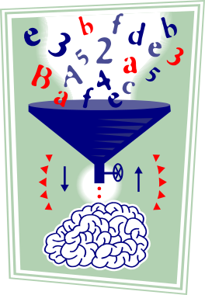


Web Mining Techniques
2- Sequential Patterns
Input
Output
/home → /product → /product/electronics
/home → /shipping → /shipping/status
Sequential Patterns
/home → /product → /product/offer → /product/electronics/tv
/home → /product → /product/electronics → /product/electronics/tv
Sequencial Pattern Mining
Click-streams

Slide 28
Web Mining Techniques
3- Clustering
    To group together a set of items having similar characteristics
    To find groups of users who share similar browsing behavior
Customer Profile
Name | Age | Income | Search Engine | Avg. Stay
John | 50 | 80,000 | Yahoo | 10 min
Tom | 25 | 90,000 | Excite | 30 min
Mary | 30 | 60,000 | Yahoo | 12 min
Paul | 48 | 55,000 | Excite | 25 min
100
cluster 1
cluster 2
A
g
e
cluster 3
static
dynamic
Income
$150,000

Slide 29
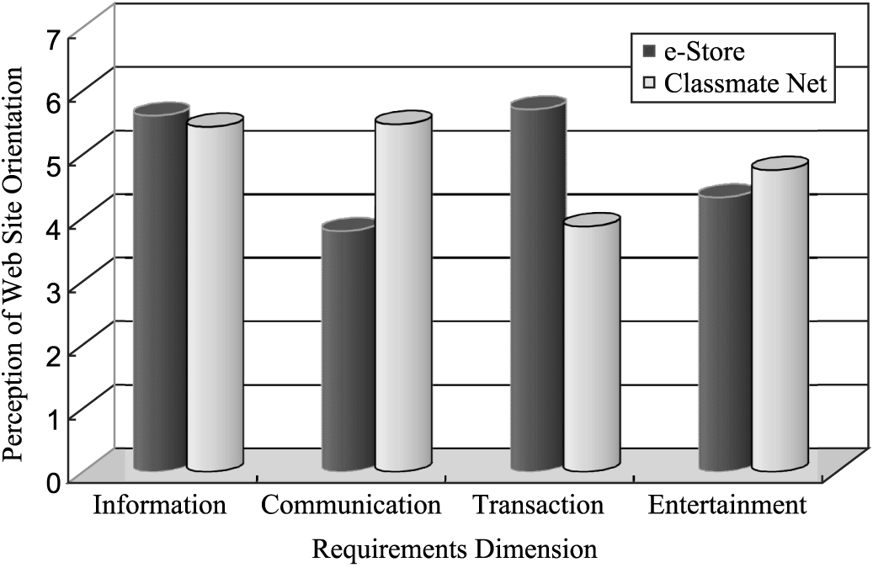
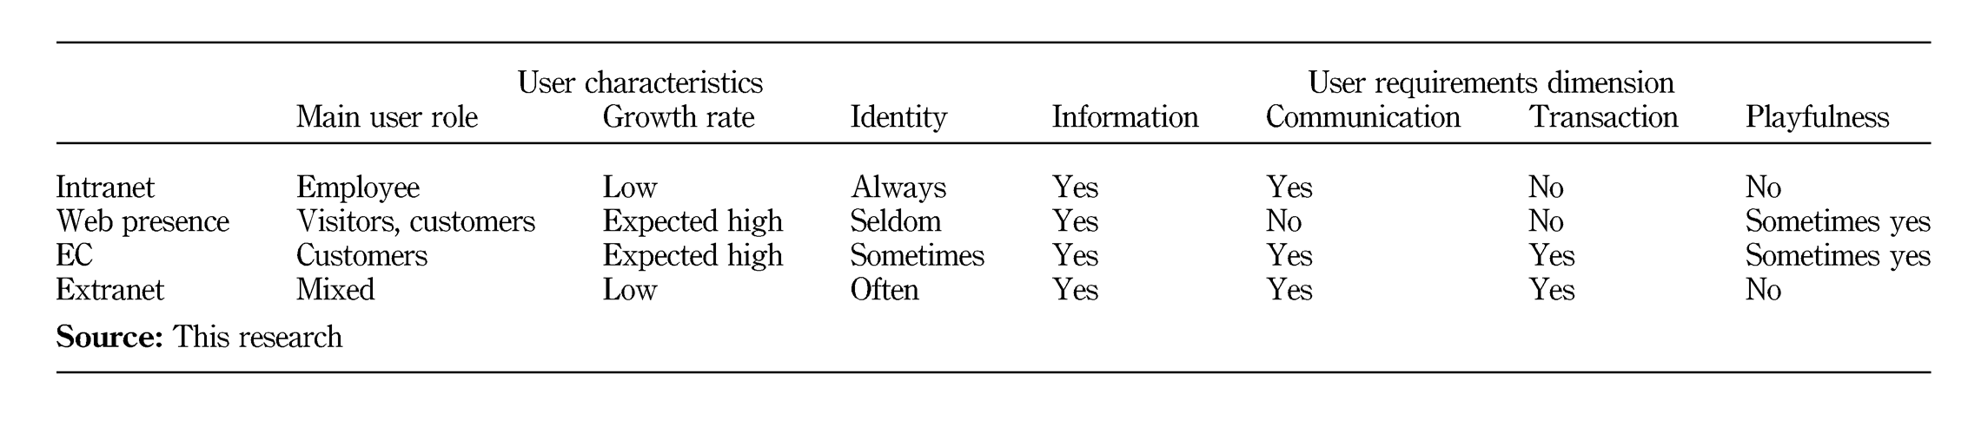
Web Mining Technique
4- Classification
Mapping a data item into one of several predefined classes
To categorize Web users according to their past access history
  Customer A belongs to the class 1 customer (ex. DINKY) in our website
user classification and requirements

Slide 30
Acknowledgement
Asst. Prof. Dr. Derya BİRANT

